Slide 1

Armbook Session ID Randomness
Kayla Hodgson

Slide 2

BURP
Utilizing the BURP Sequencer, I ran multiple Session IDs on the Armbook website to find that many of them were not unique

Slide 3
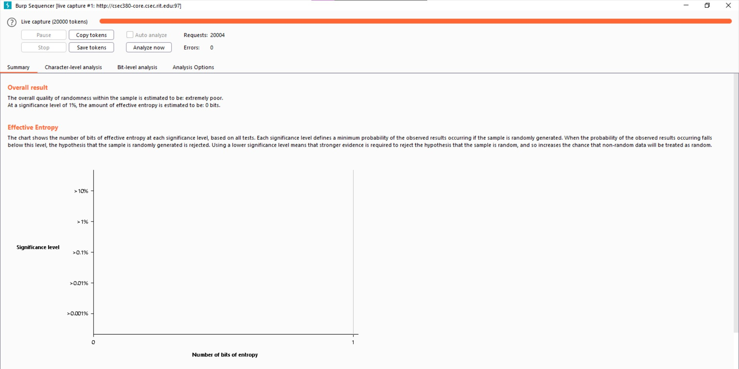
Sequencer Results

Slide 4
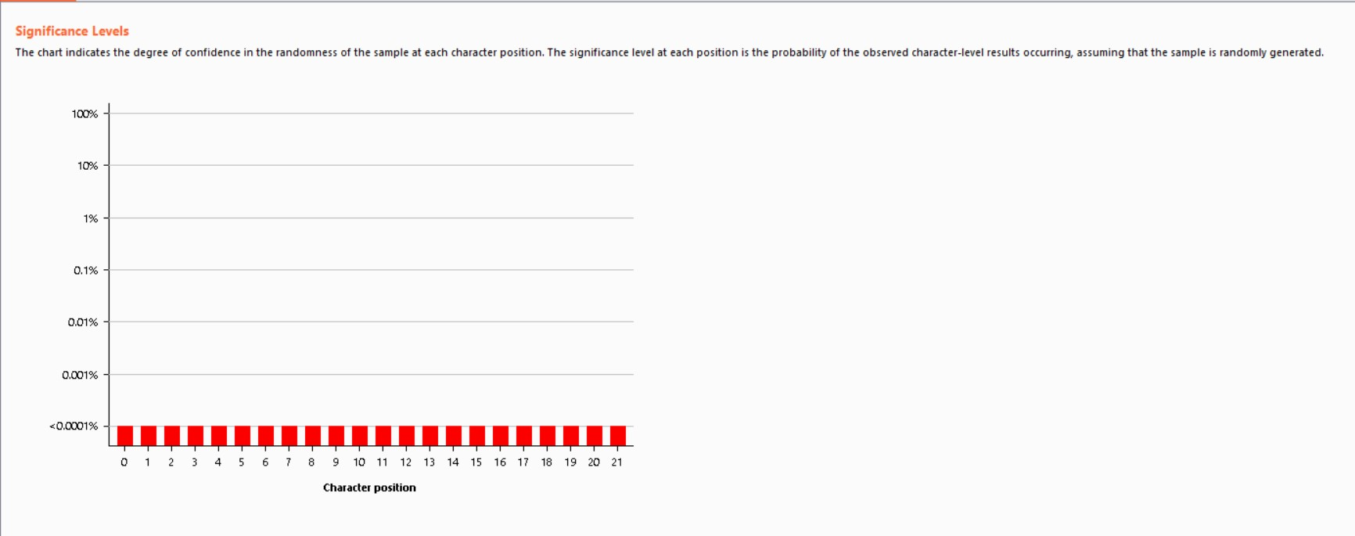
Sequencer Results

Slide 5
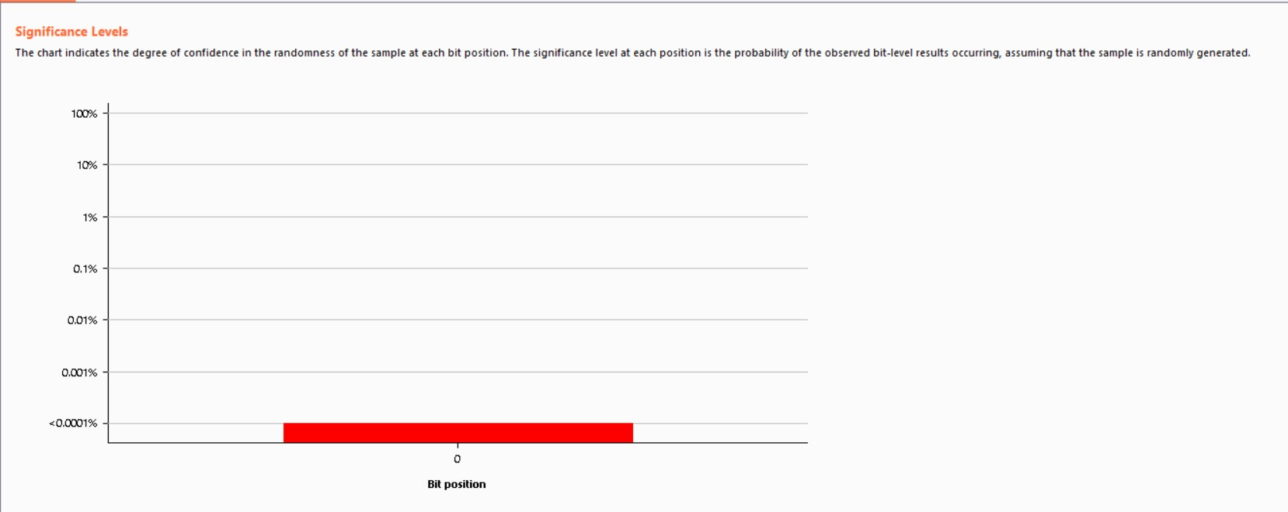
Sequencer Results

Slide 6
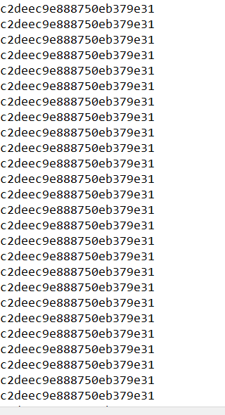
Sequencer Results
As seen in previous screenshots, the entropy level was very low signifying little to no randomness or uniqueness. Additionally, this can be seen below, out of the 2000 ids they were always the same and never changed.

Slide 7
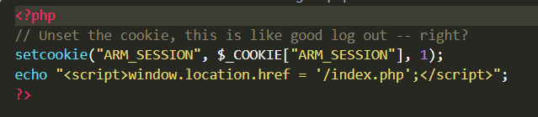
Session Logout
The issue with the Session IDs not being unique lie with the logout. The cookie is not actually being set, but is instead being set on logout
In order to fix this, session data should be erased upon logging out of Armbook on both client and server side
This invalidates the session on the server side

Slide 8
Session Logout
Additionally, another issue is that all Session IDs are generated based on time when they should instead be generated using a cryptographic function that PHP has
While generating a 22-bit Session ID, the lack of uniqueness makes this void as there is a guarantee that you can generate the same one

